Slide 1
2025 EIDA-R Education Campaign
Fostering Inclusive Practices and a Culture of Belonging Across the HPA-OHT Network
Notes:
AI-generated content may be incorrect. --- Welcome to our staff meeting focused on the EIDA-R Education Campaign. Today, we will explore our organization's dedication to equity, inclusion, diversity, and anti-racism, and how this campaign is a crucial step in ensuring culturally safe care for everyone.

Slide 2
Introduction to the HPA-OHT EIDA-R Education Campaign
Commitment to Equity
Our network is dedicated to promoting equity and ensuring that everyone has access to fair treatment and opportunities.
Inclusion and Diversity
We prioritize inclusion and diversity in all our initiatives, creating an environment where everyone feels valued and respected.
Culturally Safe Care
The EIDA-R Education Campaign aims to ensure that we provide culturally safe care to all individuals, fostering understanding and respect.
Notes:
Our organization is committed to promoting equity, inclusion, diversity, and anti-racism. The EIDA-R Education Campaign is an essential initiative designed to align with these values and ensure that we provide culturally safe care to all individuals.

Slide 3
Campaign Structure and Timeline
Flexible Learning The campaign is divided into six phases, but you’re free to jump between them, complete what’s relevant, and skip what you’ve already covered.
Go at Your Own Pace While phases follow a timeline, you can engage with them at your convenience—your journey, your timeline.
No Need to Repeat If you’ve completed similar content elsewhere, that’s fine! The campaign is designed for flexibility, so you can focus on what you need when you need it.
Notes:
The EIDA-R Education Campaign consists of six phases, each thoughtfully designed to build upon the previous one. The timeline for the campaign outlines when each phase will occur, ensuring a structured approach to training and education.

Slide 4
EIDA-R Education Campaign Phases
Phase 1: Introduction to EIDA-R Principles focuses on foundational knowledge including patient engagement. Phase 2: Enhances skills for culturally competent care. Phase 3: Addresses systemic racism and health disparities. Phase 4: Promotes 2SLGBTQIA+ health equity and gender diversity. Phase 5: Builds Indigenous cultural awareness and safety. Phase 6: Celebrates campaign outcomes and inspires commitment.
Notes:
This slide outlines the six phases of the EIDA-R Education Campaign. Each phase is designed to build on the previous one, ensuring comprehensive training that promotes equity, inclusion, diversity, and anti-racism principles. Together, these phases will enhance understanding and practices that lead to a culturally competent and safe care environment.

Slide 5
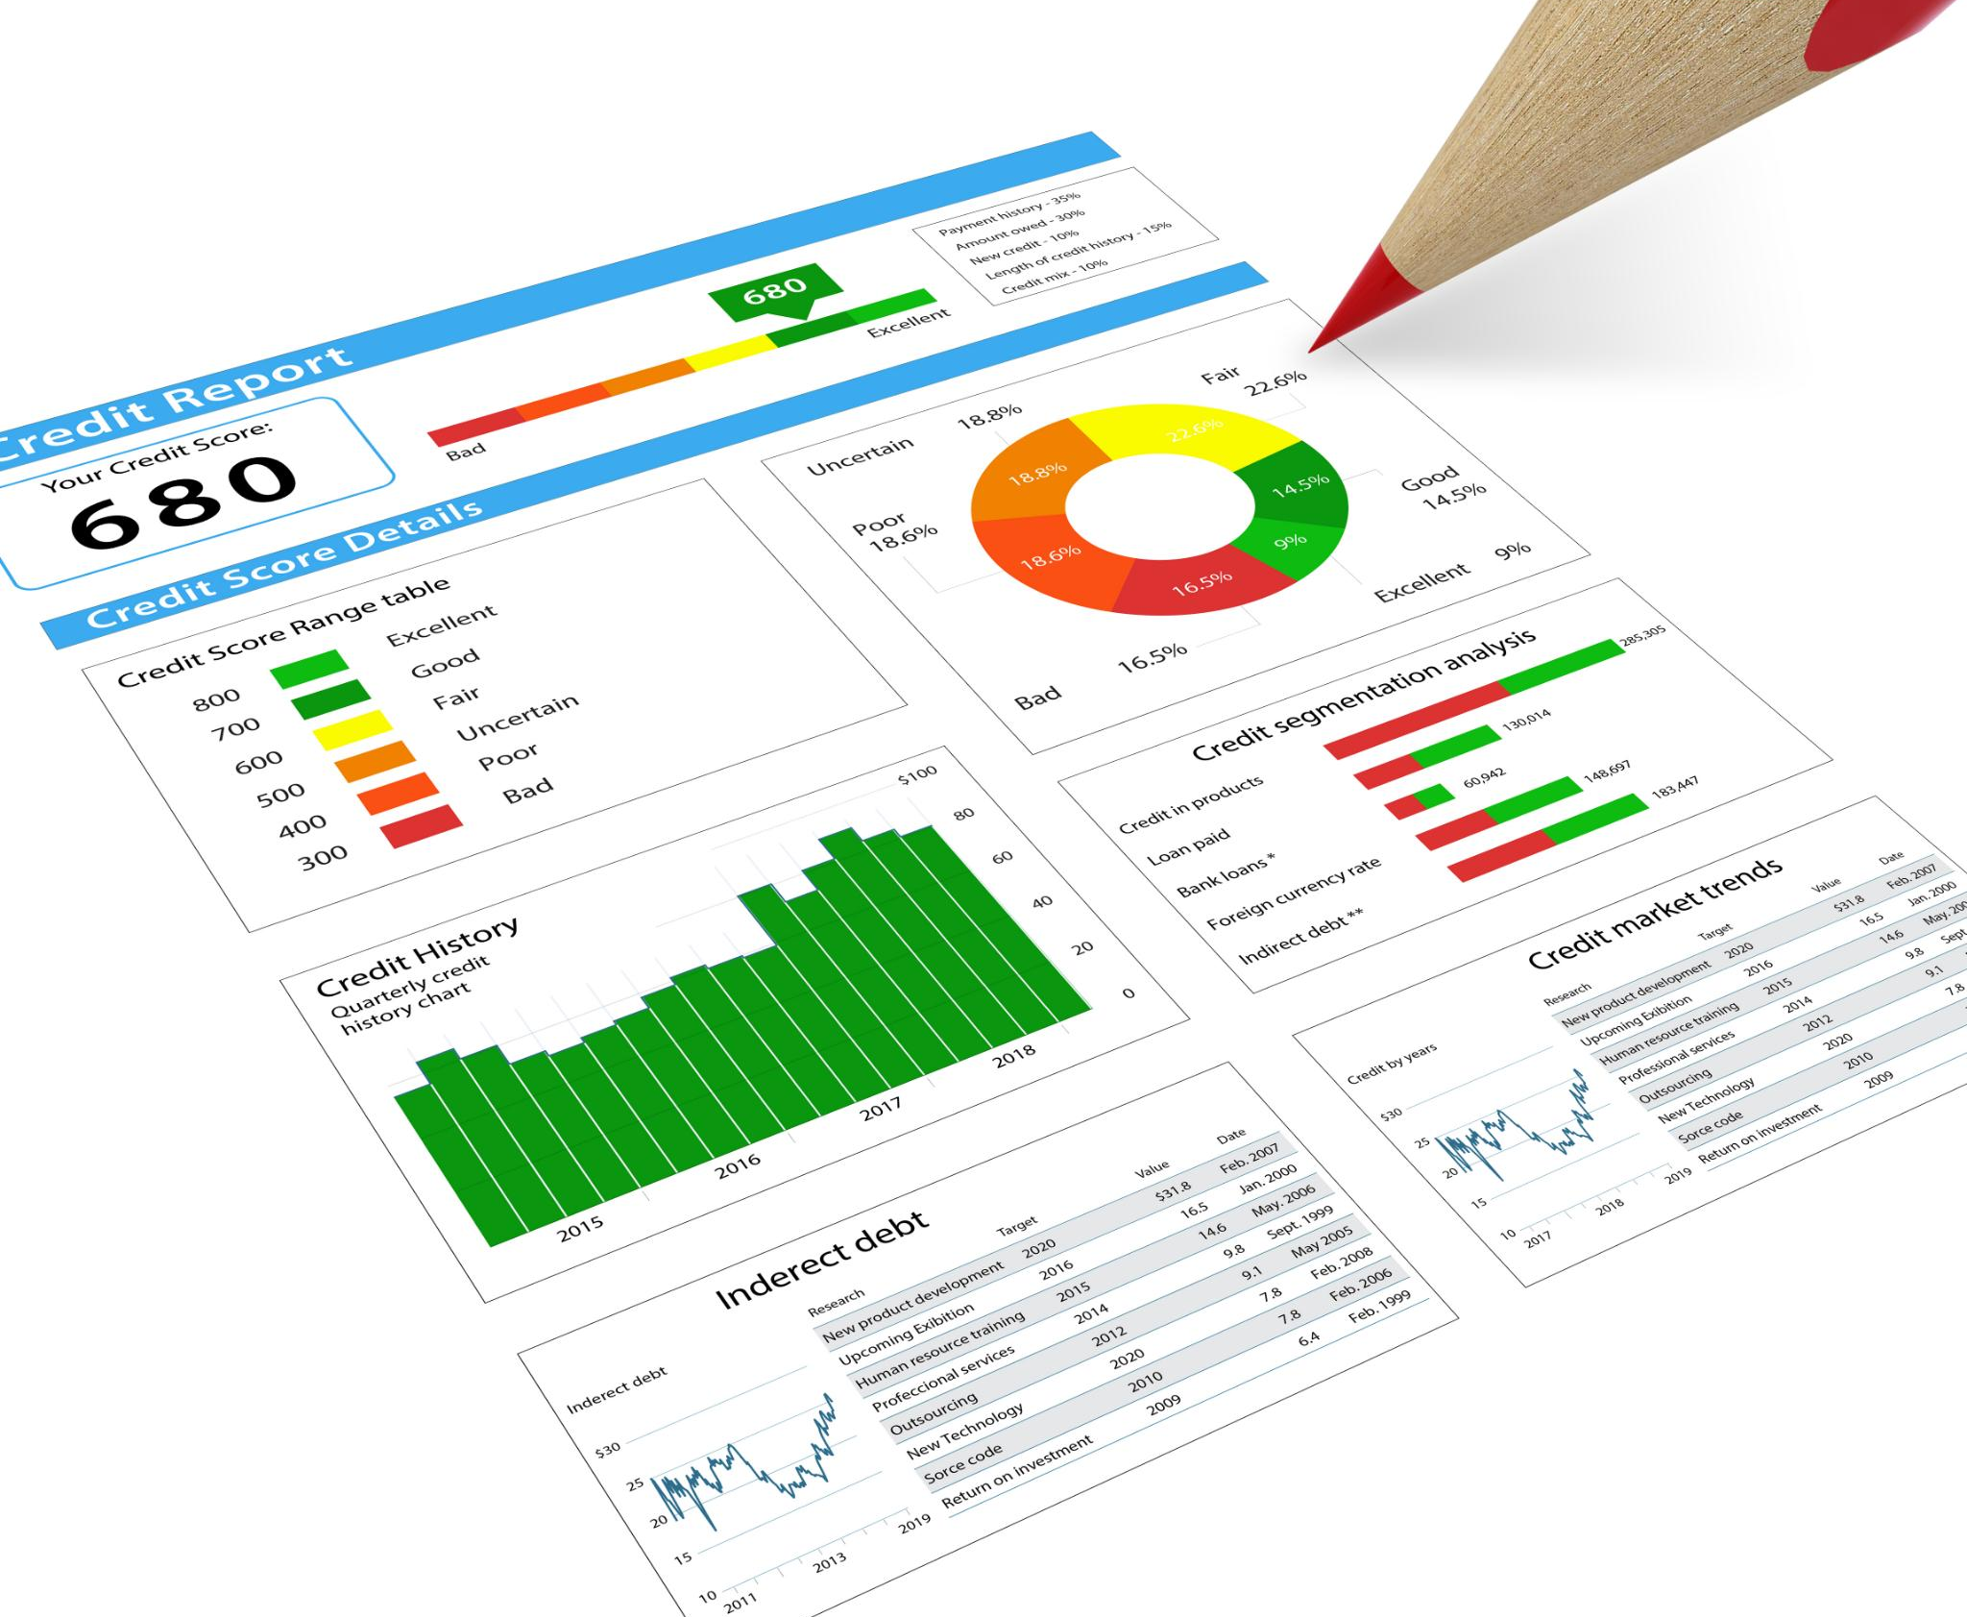
KPIs and Deliverables Overview
Training Completion Rates
We are tracking the percentage of staff completing each phase of training to ensure effective learning outcomes.
Notes:
We have established key performance indicators (KPIs) to measure our success. These include the percentage of staff completing each phase of training, participation rates in webinars and interactive sessions, and increased application of EIDA-R principles in our daily practices.

Slide 6
Importance of Compliance
Mandatory Compliance Standards
Meeting Service Accountability Agreement (SAA) deliverables is essential for maintaining compliance within our organization and fostering trust with stakeholders.
Collective Responsibility
It is our shared responsibility to ensure that compliance standards are met to create an equitable working environment.
Equitable Environment
Striving for compliance helps our organization work towards a more equitable environment for everyone involved.
Notes:
Meeting TPA and SAA deliverables is mandatory for our organization and is critical for maintaining compliance. It is our collective responsibility to ensure these standards are met as we work towards a more equitable environment.

Slide 7
Incentives for Participation
Professional Development Opportunities
We provide various professional development opportunities aimed at enhancing your skills and knowledge within the organization.
Certificate of Completion
Participants will receive a certificate of completion for their work, recognizing their achievements and commitment to growth.
Team Strengthening
This initiative supports not only individual growth but also strengthens our overall team dynamics and collaboration.
Alignment with Organizational Goals
Our professional development initiative aligns with broader organizational goals, fostering a culture of continuous improvement.
Notes:
We are excited to offer professional development opportunities, including certificates of completion for each phase of the campaign. This initiative not only supports your growth but also strengthens our team and aligns with our broader organizational goals.

Slide 8
Encouraging Active Participation
Importance of Engagement
Engagement is crucial for the success of the EIDA-R Education Campaign, fostering a collaborative environment.
Creating Inclusivity
Active participation helps in creating an inclusive environment, promoting cooperation and understanding among all members.
Promoting Organizational Values
By participating, you contribute to promoting the values of our organization and enhancing community connections.
Notes:
Engagement is essential for the success of the EIDA-R Education Campaign. By participating, you will help us create a more inclusive environment and promote the values we stand for as an organization.

Slide 9
Action Required: Next Steps
Register for the Campaign
Please register for the campaign by scanning the QR code or using the provided link. Your participation is essential.
Leadership Support
Leadership is committed to supporting your participation and providing the necessary resources for success.
Creating Change Together
By working together, we can drive impactful change within the organization and our community.
Notes:
To get started, please register for the campaign using the provided QR code or link. Leadership is committed to supporting your participation and ensuring that we achieve the campaign goals together.

Slide 10
Commitment to Support Participation
Leadership Support
Our leadership is committed to supporting this initiative with the necessary resources for all staff members.
Resource Allocation
We are dedicated to providing essential resources that facilitate active participation from all staff.
Creating Change Together
By working together, we can drive impactful change within the organization and our community.
Notes:
Our leadership stands firmly behind this initiative and is dedicated to providing the necessary resources and support for staff participation. Together, we can create impactful change.

Slide 11
Questions & Ideas
Notes:
As you conclude this presentation, take action by identifying your next negotiation opportunity. Apply at least one new tool or technique from what you've learned. Document your outcomes and share your experiences to encourage growth. Utilize available resources to continue your development.

Slide 12
Thank You!
Funding provided in part by:

